Slide 1



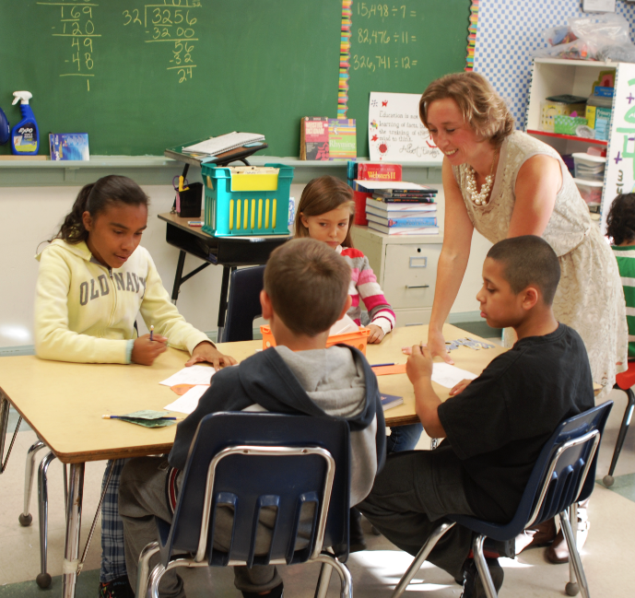
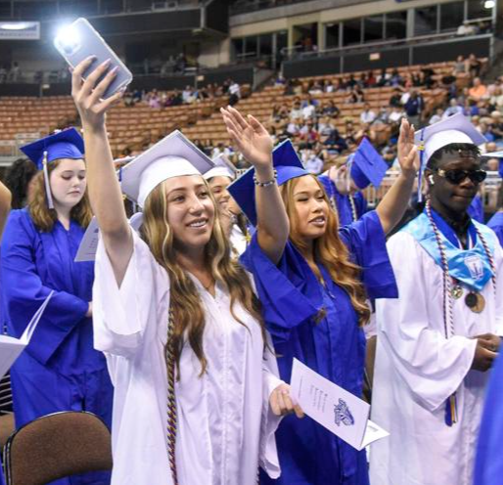
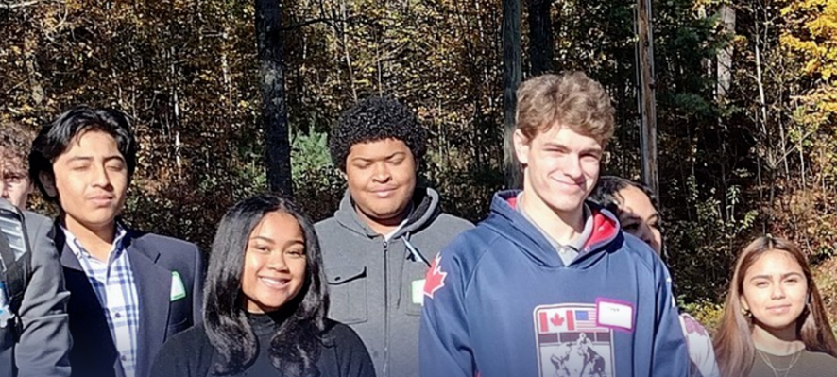


Community Kick-Off
April 4, 2023
Envisioning
the MSD
Master plan
newvistadesign

Slide 2
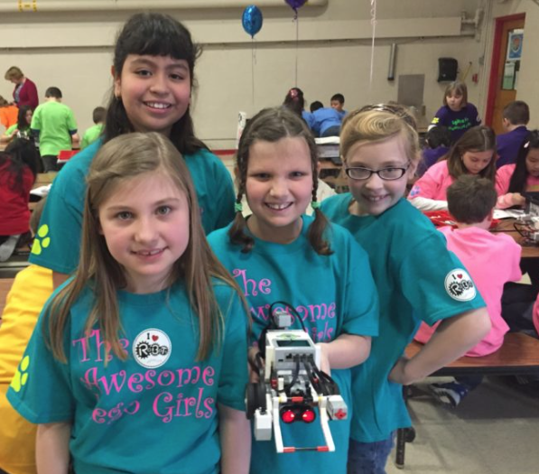

Agenda
Welcome and Framing
Introductions
Master Planning Overview and Timeline
Visioning Overview and Prompts
Priorities: Educational, Architectural, and Community
21st Century Schools and Design Patterns
Blue Sky Ideas
Q&A
newvistadesign

Slide 3
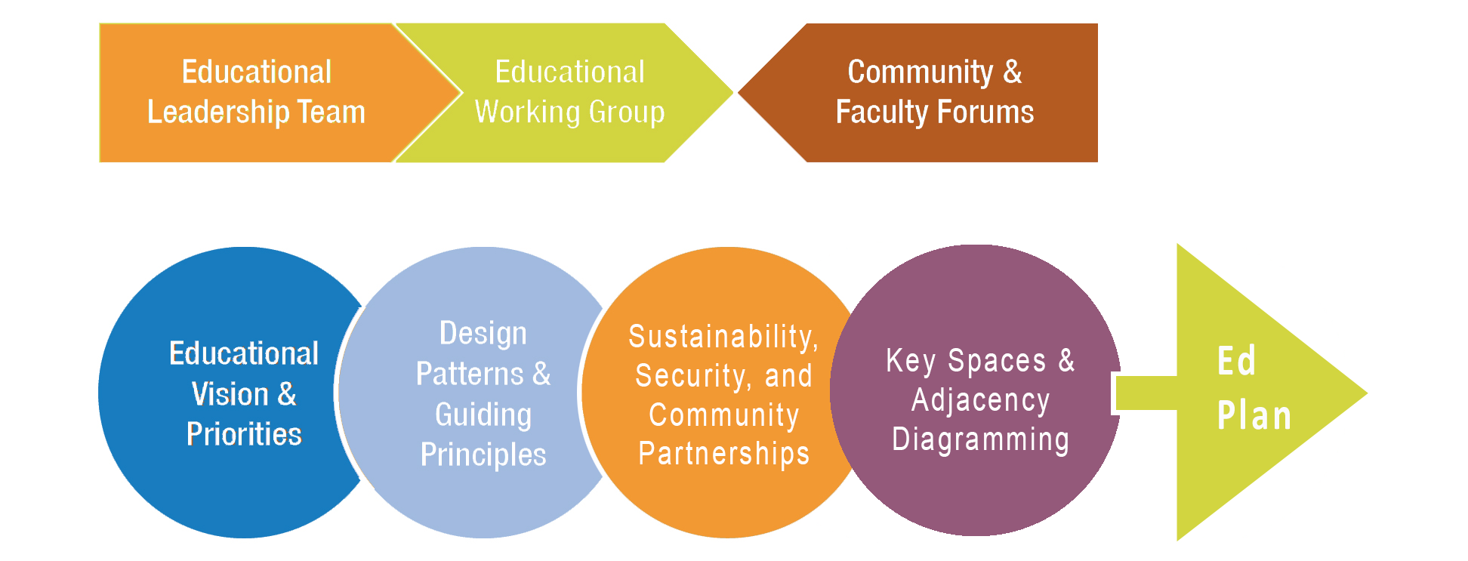
The Visioning Process
newvistadesign

Slide 4
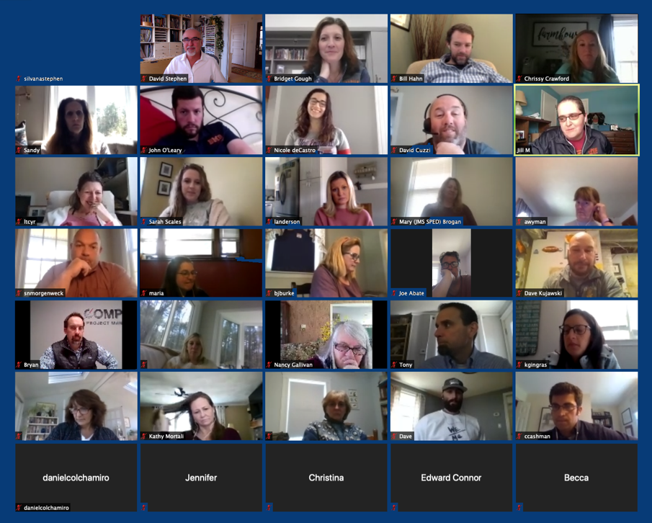
Virtual Visioning
Shorter Workshops
Highly Interactive
Breakout Groups Discussions
Chat Function Feedback
Google Docs Info Collection
Interactive Software for Real-Time feedback
newvistadesign

Slide 5
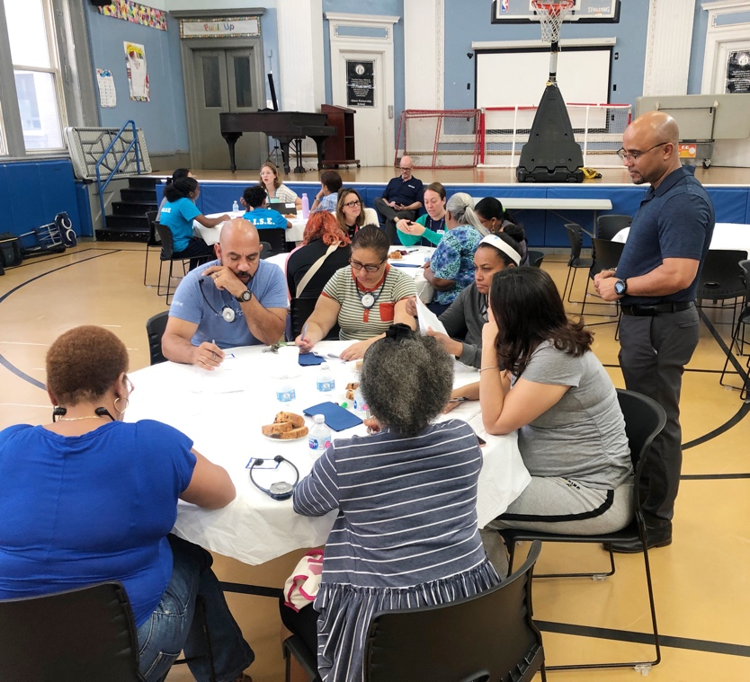
Developing a Narrative
Educational vision as connected to design priorities and goals
Desired spaces and adjacencies
Optimization of existing, renovated, and new facilities
Connections to Community Plan and Strategic Plan
newvistadesign

Slide 6
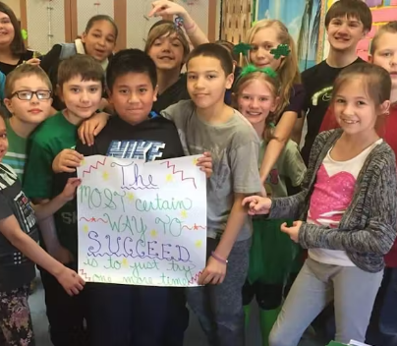
Building Upon
MSD Policies
School Goals
Community Plan: Vetting Process and Goals, and building buy in and excitement
Other Sources?
newvistadesign

Slide 7

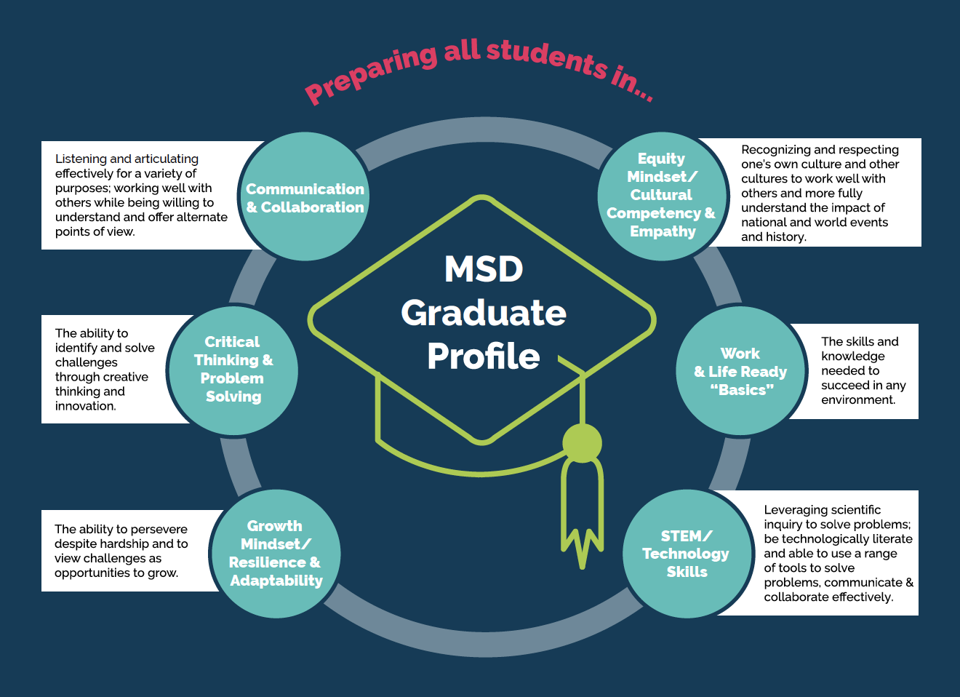
Community Plan
newvistadesign

Slide 8
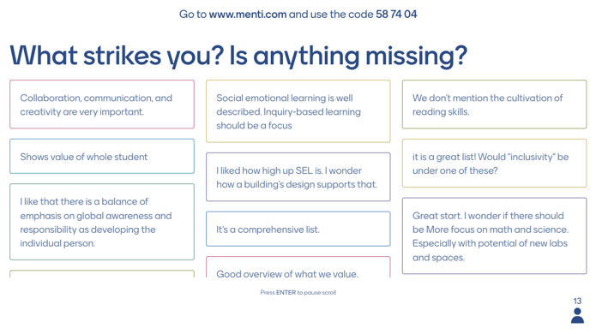
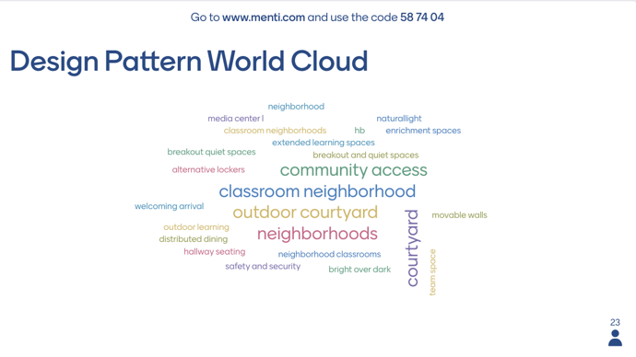
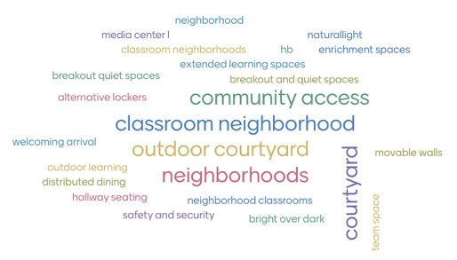
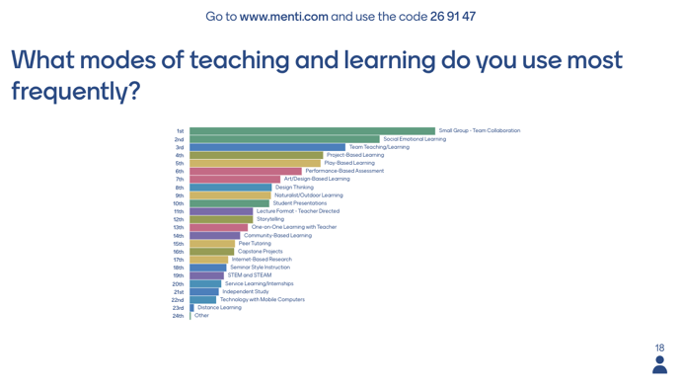
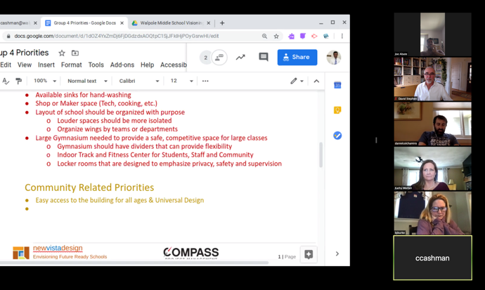
In Person and Virtual Workshops,
and Community Questionnaire and Videos
newvistadesign

Slide 9
Introductions
Role/Affiliation and Greatest Hopes
for the Master Planning Process

Slide 10
Priorities
Educational, Architectural, and Community

Slide 11
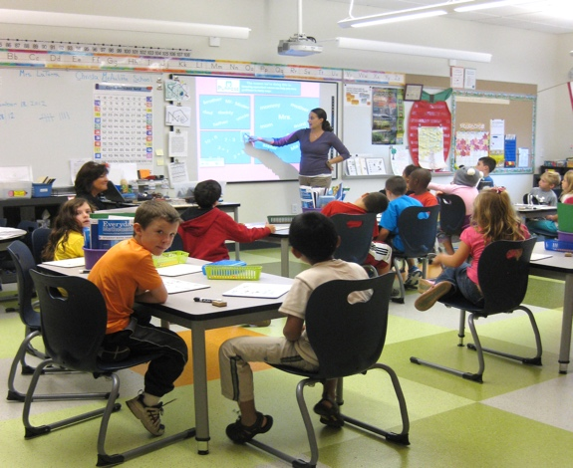
Any renovated
or new schools will have…
ADA Compliance
Safe Entry and Security Features
Thermal Comfort (Heating and Cooling)
Modern Technology and Furniture
Well-Sized Classrooms with Natural Light
newvistadesign

Slide 12
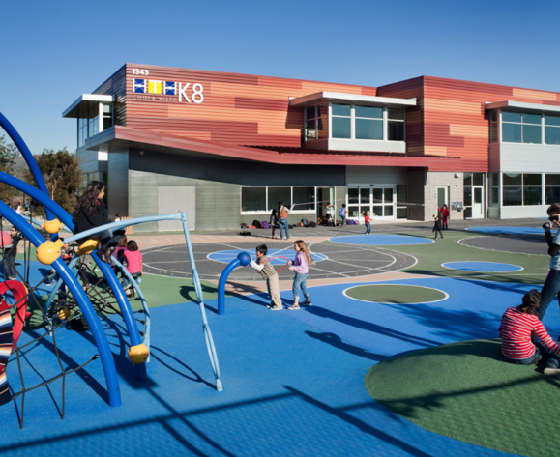
Any renovated
or new schools will also have…
Indoor/Outdoor Connectivity
Push-In Special Ed (Breakout Rooms)
Safe Drop-Off and Pick-Up
Sustainable Building Features
Adequate Number of Distributed Bathrooms and Gender-Neutral Bathrooms
newvistadesign

Slide 13
This is an
Opportunity to…
Reflect on your District and School Agenda and Needs
Push your thinking about what is possible
Envision an approach to facility use and design that will position you for decades to come
Be practical and forward thinking…
Be ASPRATIONAL in your thinking! Compromises will need to be made
newvistadesign

Slide 14
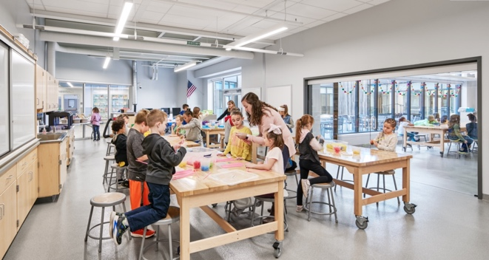
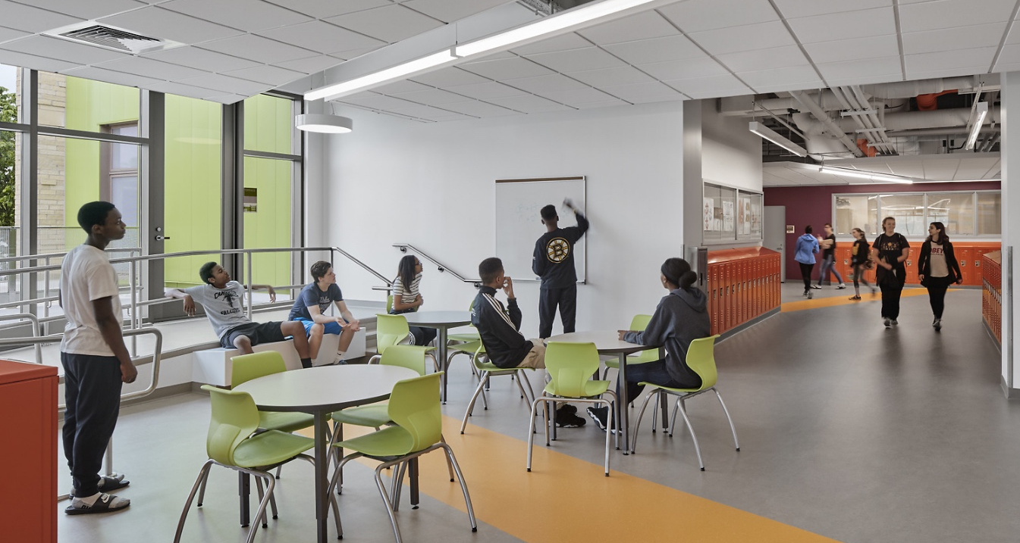
Overarching Themes
Use every square inch of the building
Create flexible and multi-use spaces
Extend learning beyond classroom walls
Build synergy and connectivity between varied spaces
Define learning clusters and communities
newvistadesign

Slide 15
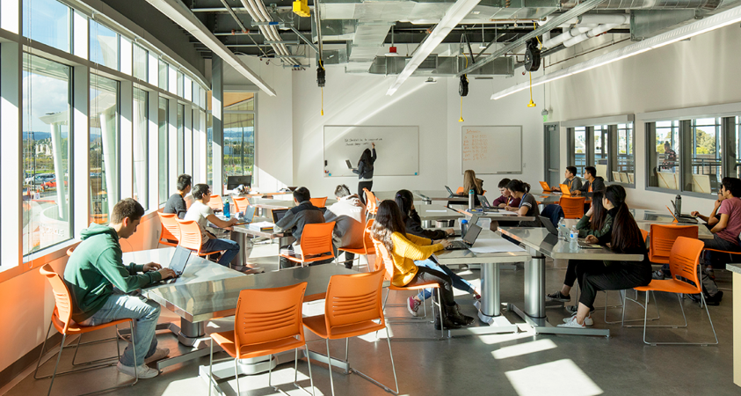
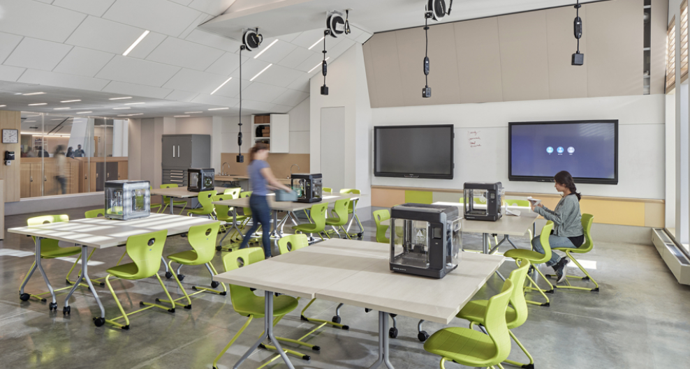
Overarching Themes
Provide agile and multi-purpose classrooms
Provide venues for hands-on learning
Support community use and access
Foster community connections
newvistadesign

Slide 16
Instructions

Slide 17
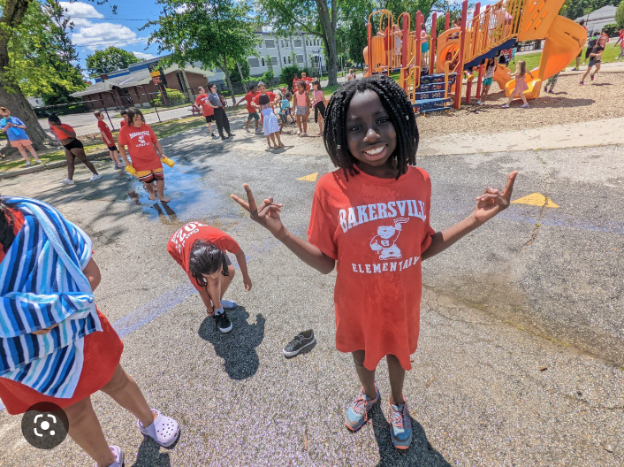
Initial District Educational Priorities
Equity and Inclusion
Whole Child Approach
Problem- and Inquiry-Based Learning
Community and Family Engagement
Teacher Collaboration
Health and Wellness
Outdoor Learning
Seamless Technology Integration
newvistadesign

Slide 18
Initial District Architectural Priorities
Transforming MSD Learning Spaces
Dynamic and Flexible Spaces for Learning
Equity of Space
Welcome and Warmth
Safety
Good Daylight
Seamless Technology
Meeting and Gathering Spaces
Health and Wellness
Sustainability
Good Wayfinding
Good Storage
Gathering Hubs
Ease of Maintenance
The Arts
Science Labs
Outdoor Connections
newvistadesign

Slide 19
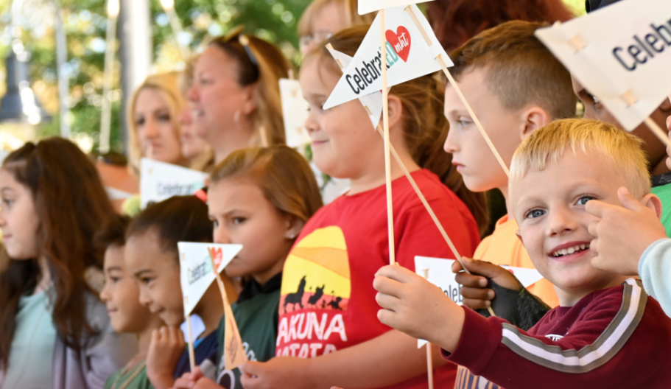
Initial District Community Priorities
Creating a Workable and Cohesive Facilities Master Plan
Architectural Merit and Relevance
Engaging Varied Stakeholders and Building Community Buy-In
Attracting New Families
Practical and Cost Effective
Safe Community Use and Access
Welcome and Warmth
School as Community Hub
Appropriate Fit
Neighborhood Impact
City Elections
newvistadesign

Slide 20
Future Ready
Learning Goals and District Initiatives

Slide 21
MSD Graduate Profile
Communication & Collaboration
Critical Thinking & Problem Solving
Growth Mindset/Resilience and Adaptability
Equity Mindset/Cultural Competency & Empathy
Work & Life Ready Basics
STEM/Technology Skills
newvistadesign

Slide 22
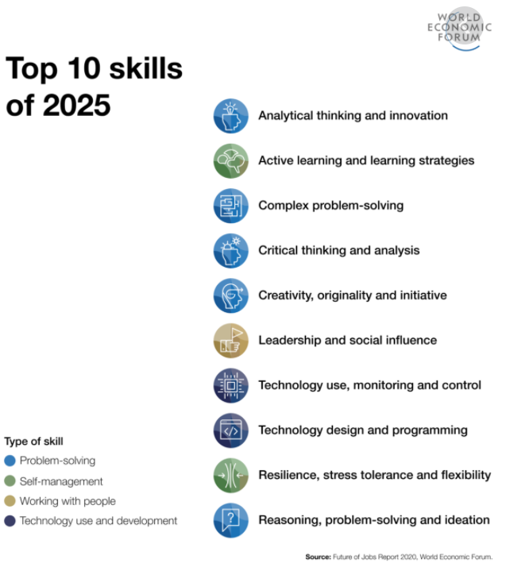
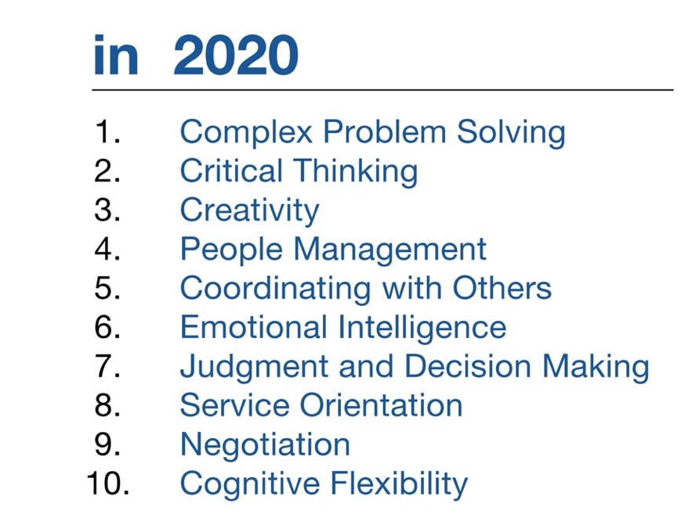

Skills for a
New Economy
newvistadesign

Slide 23
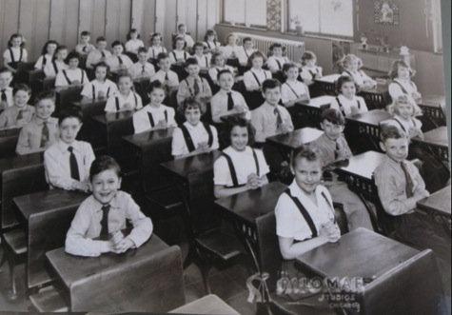


Educational Delivery
What do your district and school value?
Where do you want to be?
Teacher-Centric |  | Student-Centric
Passive Learning |  | Active Learning
Classrooms |  | Flexible Learning Environments
Conventional Technology |  | 1:1 Technology Environments
Individual |  | Collaborative
Subject-Based |  | Project-Based
newvistadesign

Slide 24
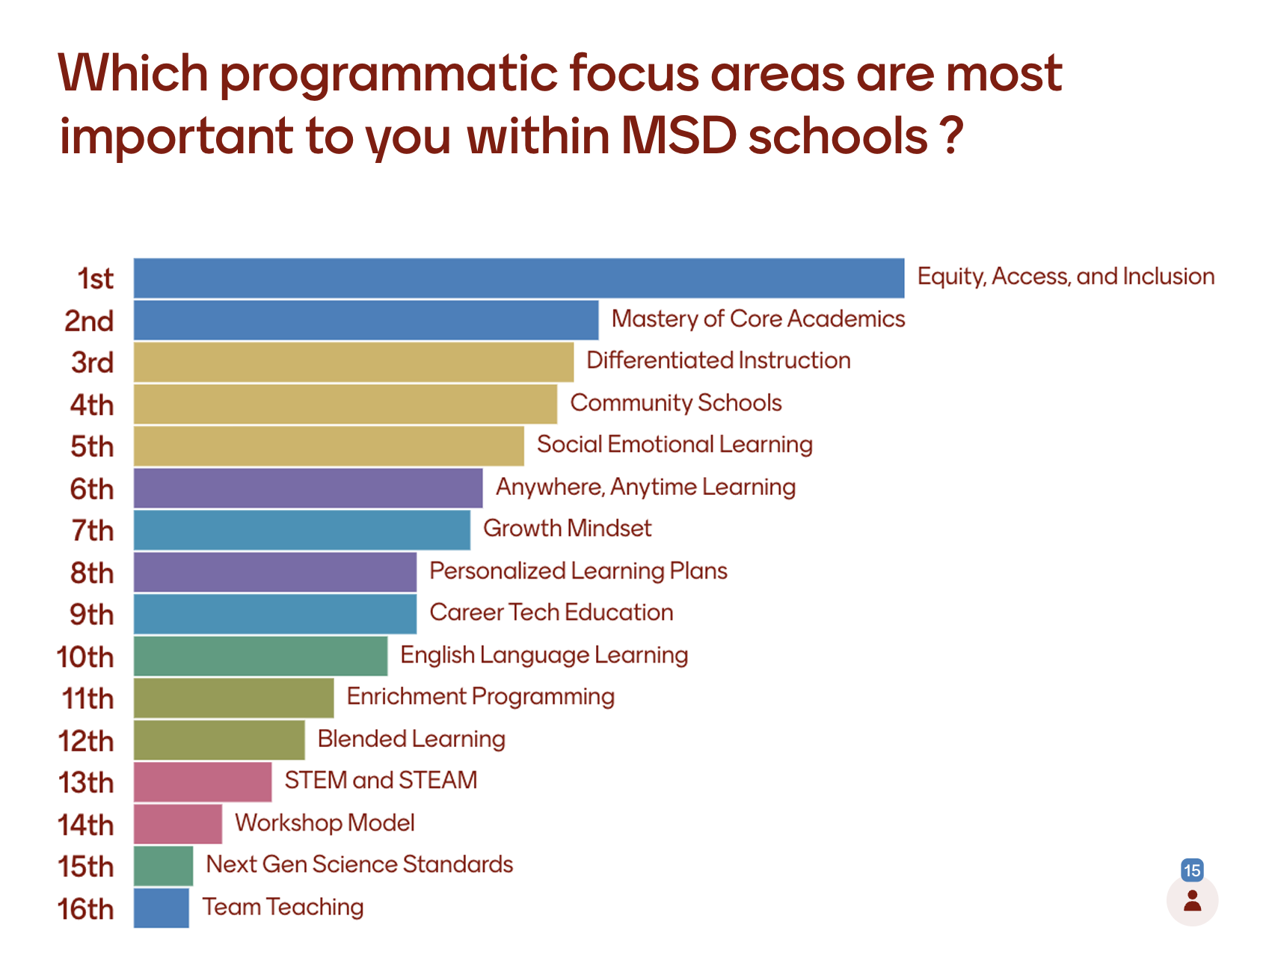
Key Programmatic Focus Areas
Equity, Access, and Inclusion
Mastery of Core Academics
Differentiated Instruction
Community Schools
Social Emotional Learning
Anytime Anywhere Learning
Growth Mindset
Personalized Learning Plans
Career Tech Education
English Language Learning (ELL)
Enrichment Programming
Blended Learning
STEM and STEAM
Workshop Model
NextGen Science Standards
Team Teaching
newvistadesign

Slide 25
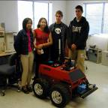
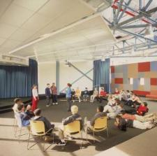
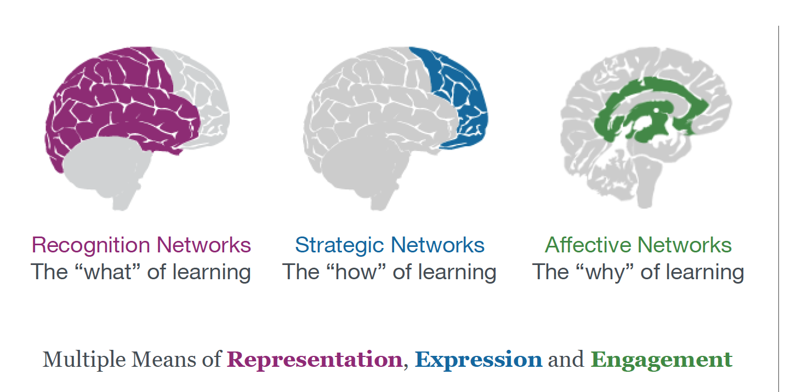

Equity, Access, and Inclusion
Identifying students' individual needs, removing barriers to access, and providing appropriate accommodations for those students who need them.
Universal Design for Learning
Varied Delivery Methods
EL Programming
Hands-On Learning
Action and Expression
newvistadesign

Slide 26
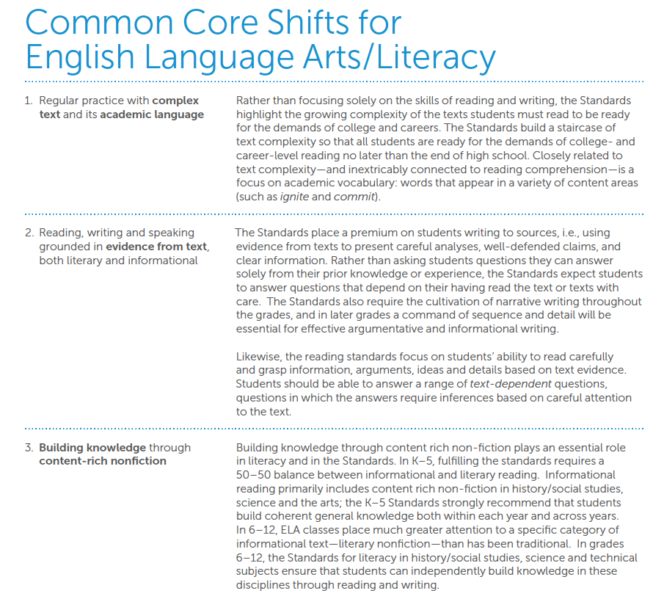
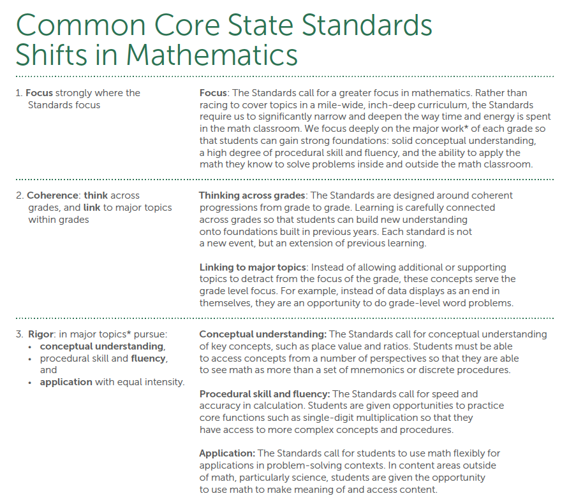
Mastery of Core Academics
21st Century Skills (See the 4 C’s below)
Common Core State Standards
Lifelong Learning
PreK - 12 standards-based curriculum that scaffolds to expectations for graduation and is aligned to the Manchester Academic Standards.
Concepts and Skills
Problem Solving
Thinking Across Grades
Conceptual Understanding
Fluency
Application
Complex Text
Academic Language
Evidence from Text
Building Knowledge
Content-Rich Nonfiction
newvistadesign

Slide 27
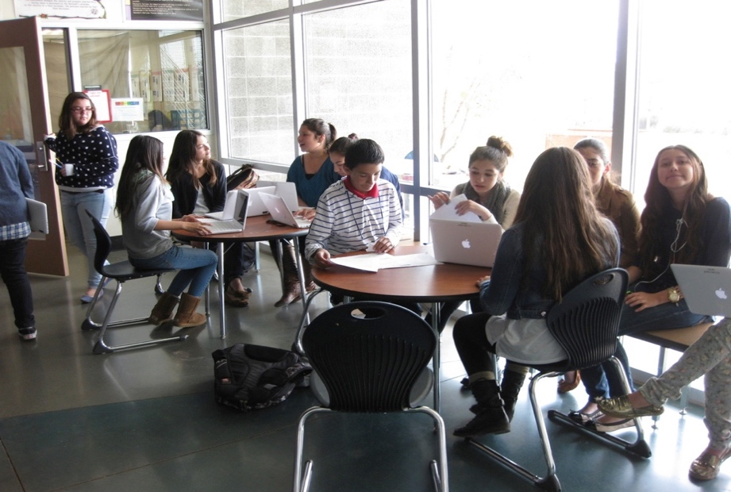

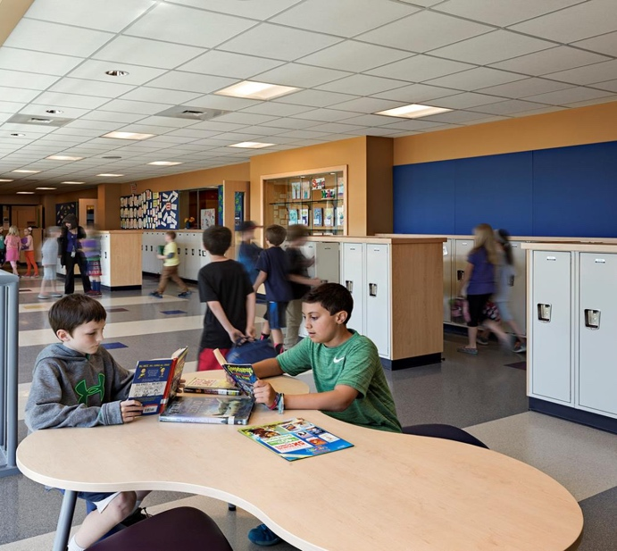
Push-In / Differentiated Instruction
English Language Learners
Sub-Separate Programming
Co-Teaching
Learning Stations
newvistadesign

Slide 28
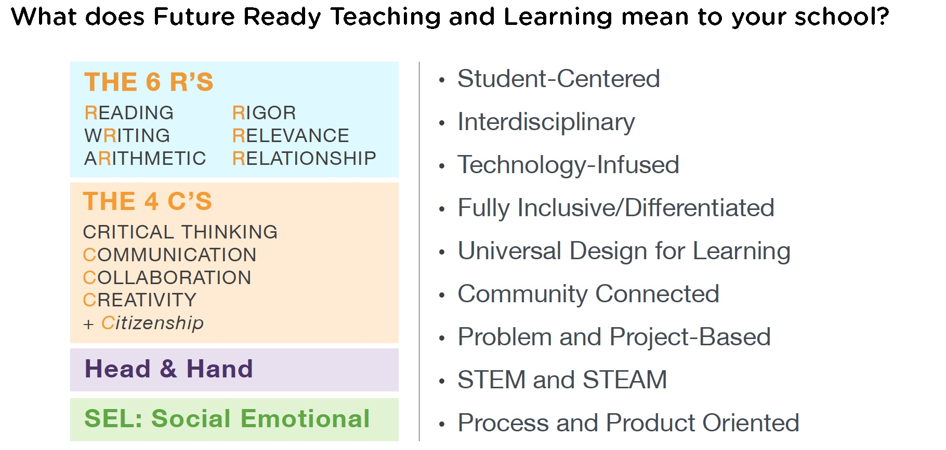
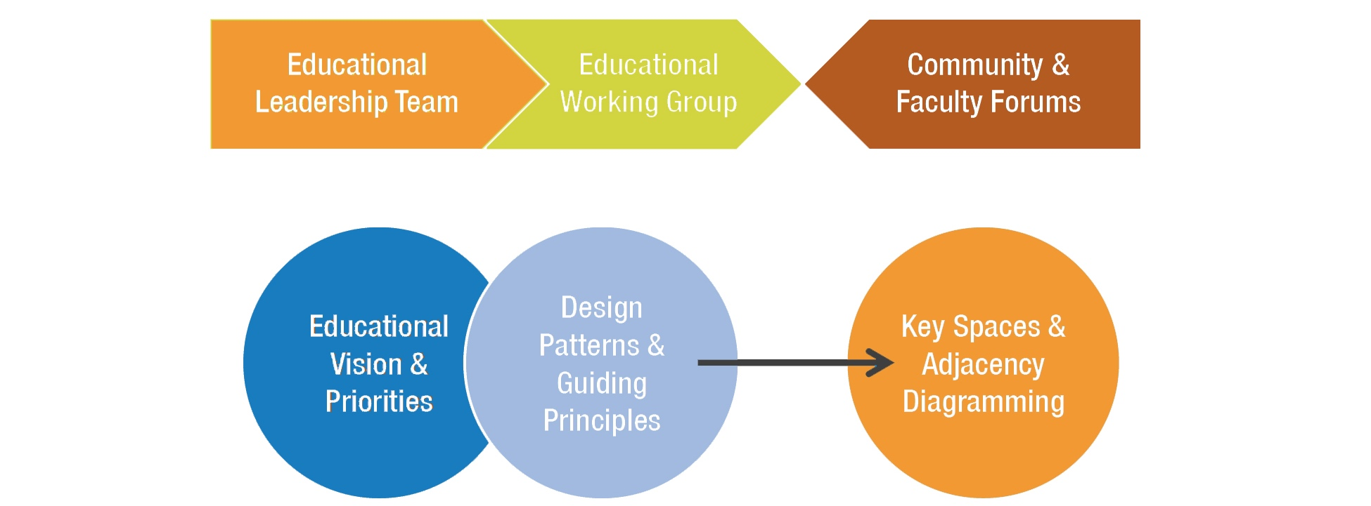
21st Century Skills
newvistadesign

Slide 29
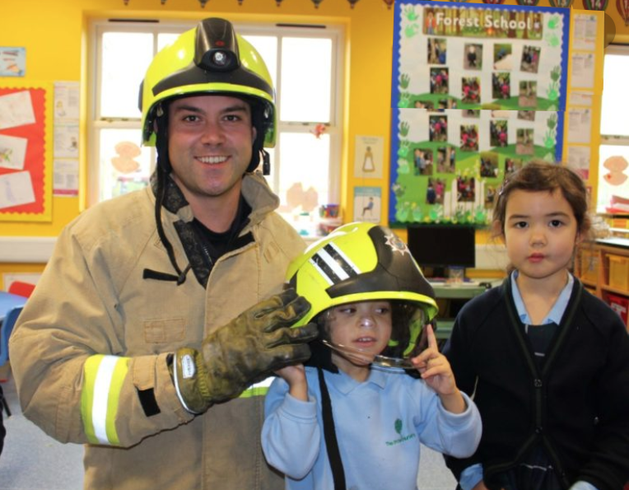
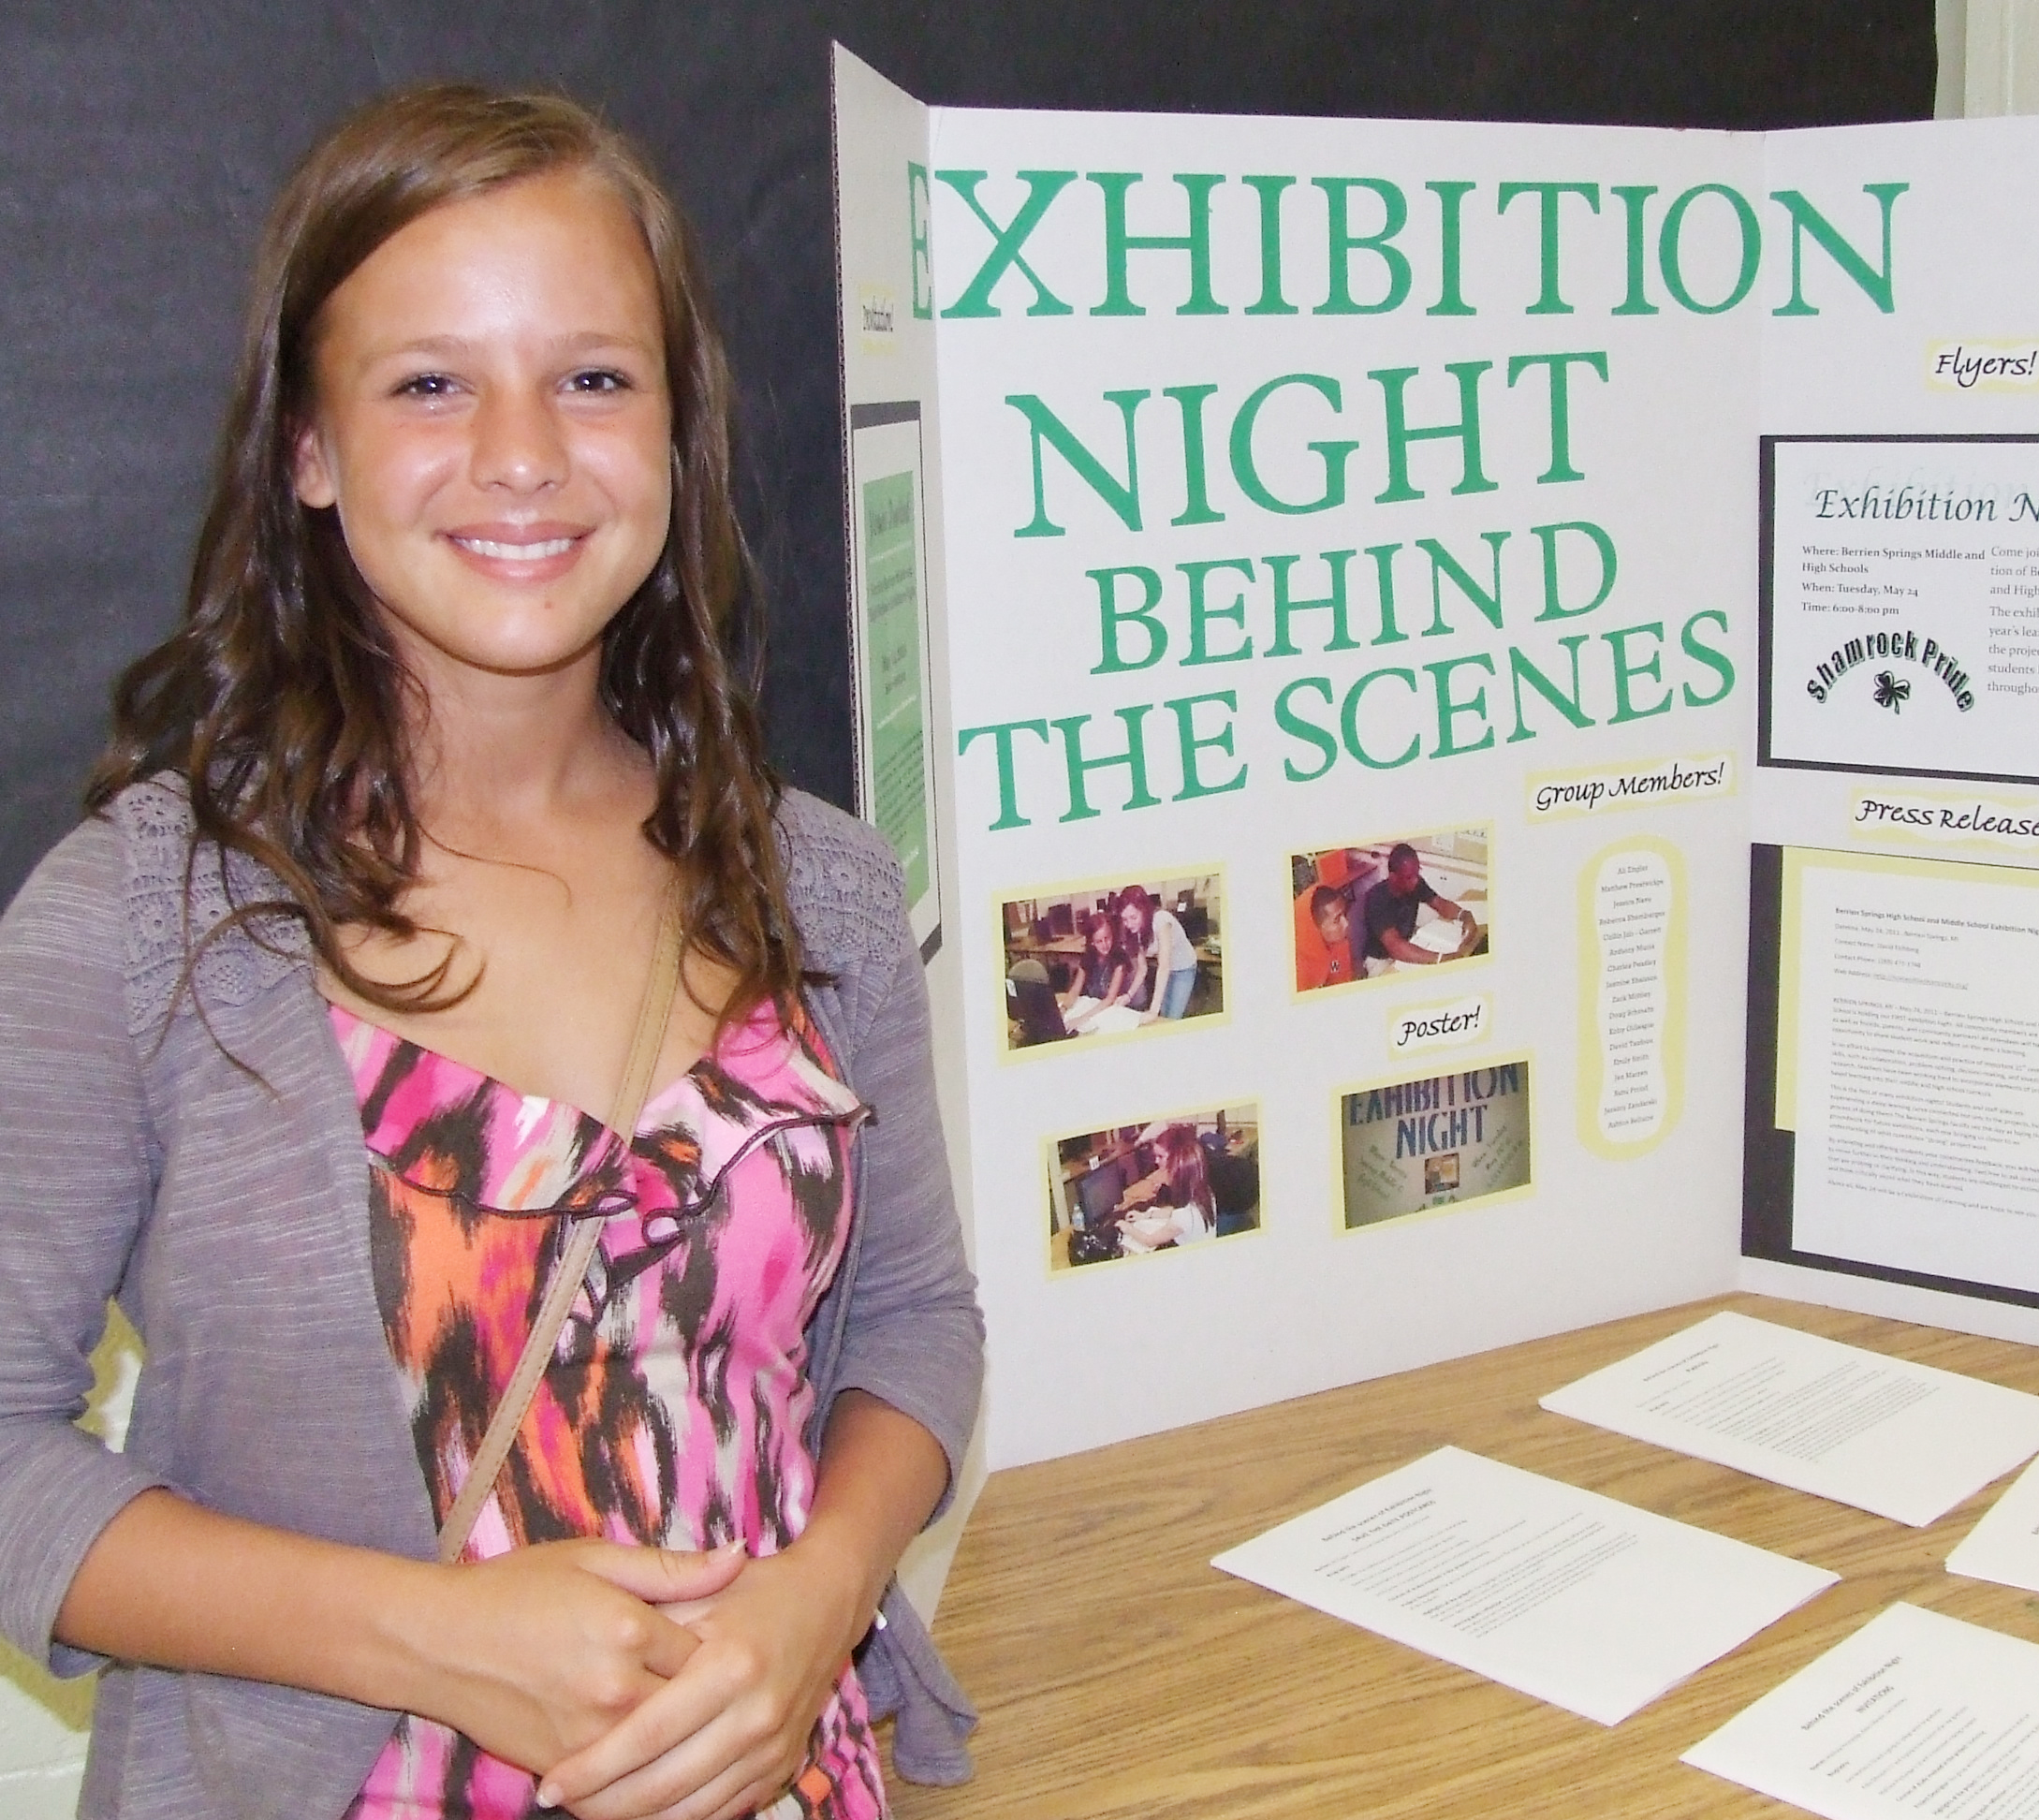
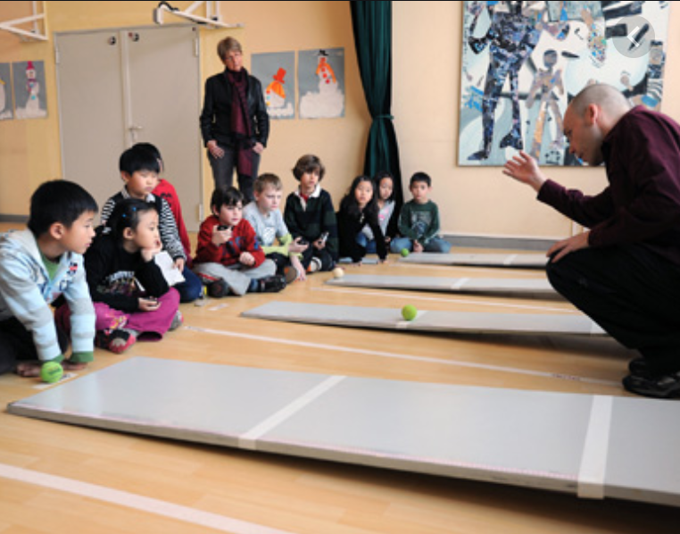
Community Schools
Community Access and Engagement
School as Community Hub and Resource
Authentic Contexts
Parental Involvement
Adult-World Connections
Field Studies
newvistadesign

Slide 30
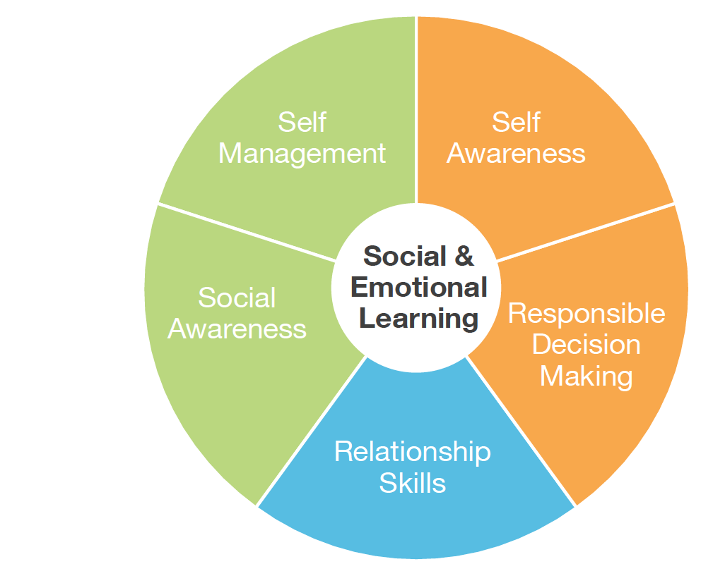
Social Emotional Learning
Character education
Growth Mindset
Mental health
Mindfulness
Resilience and Grit
Classroom management
newvistadesign

Slide 31
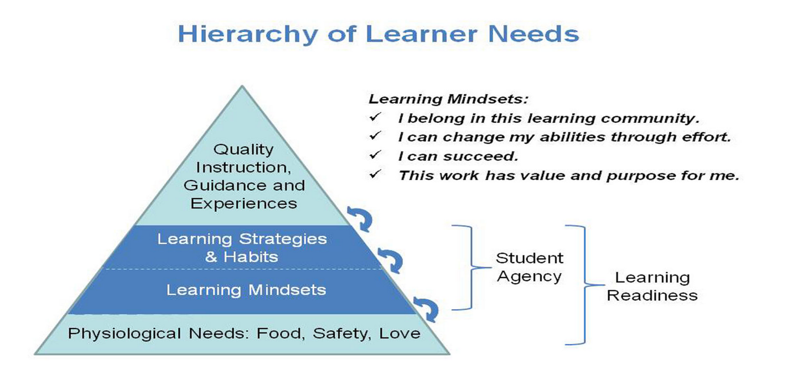
Academic/Growth Mindset
Moving beyond kids being just naturally good at math and science to providing examples
… Integrity, responsibility and
Perseverance…
newvistadesign

Slide 32
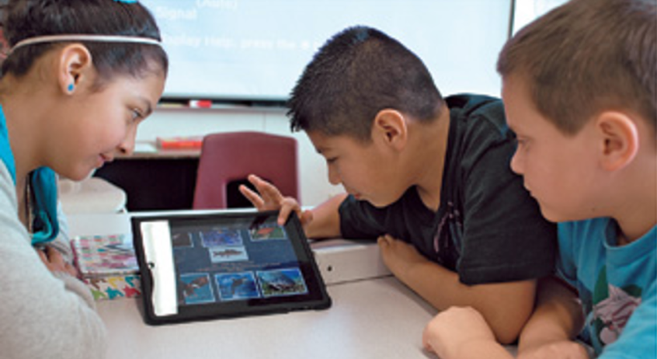
Personalized Learning Plans
Student Led Conferencing
Portfolio Defenses
Competency-Based Framework
Learning Progressions Toward Mastery
newvistadesign

Slide 33
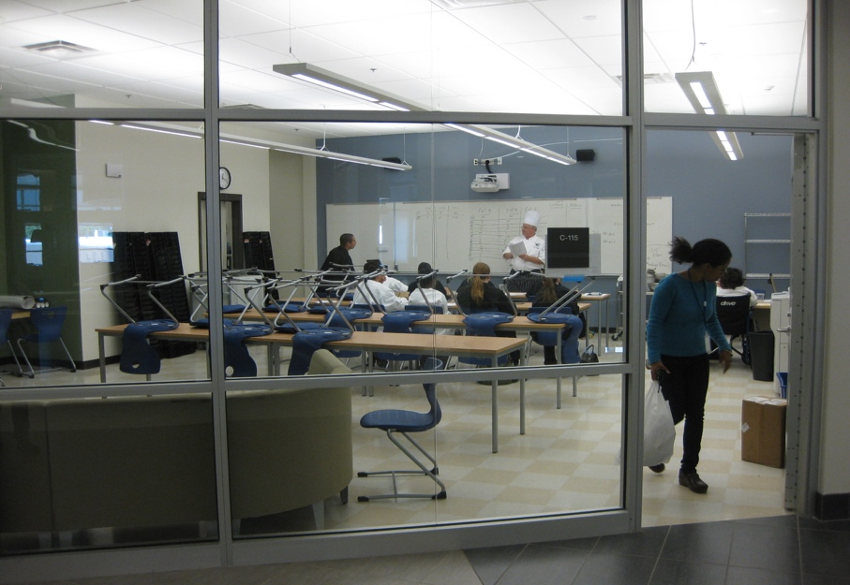
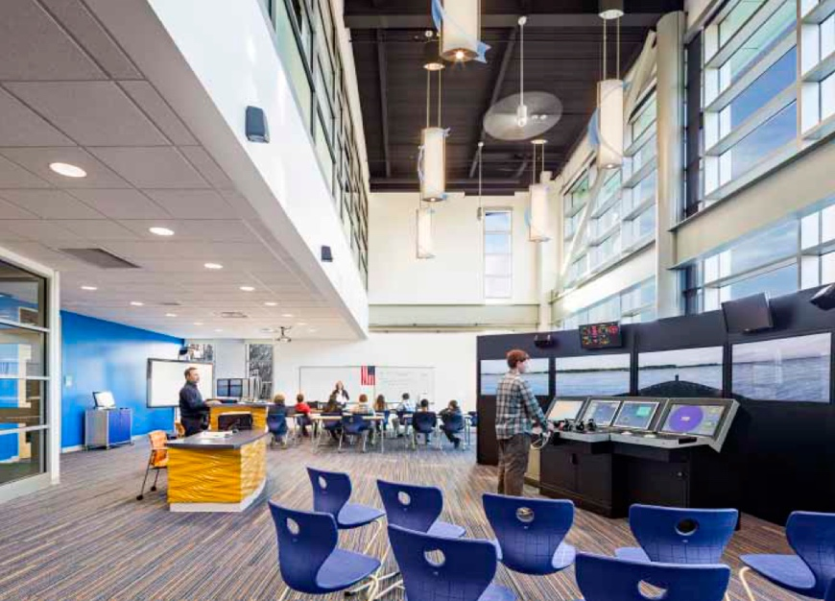
Career Tech Education
Career Pathways
Community Partners
Vocational/Academic Integration
Extended Learning Opportunities
newvistadesign

Slide 34

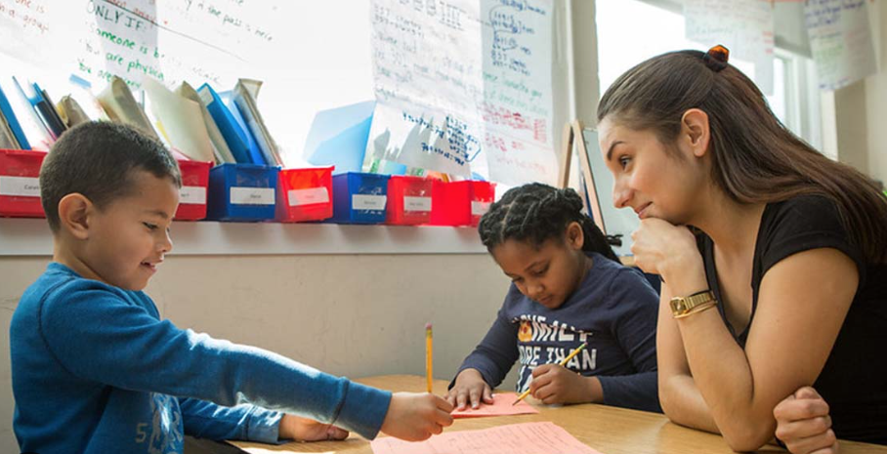
English Language Learning
Understanding, reading, listening, speaking, and writing of the English language through the development of literacy and academic skills in grade level content areas

Slide 35
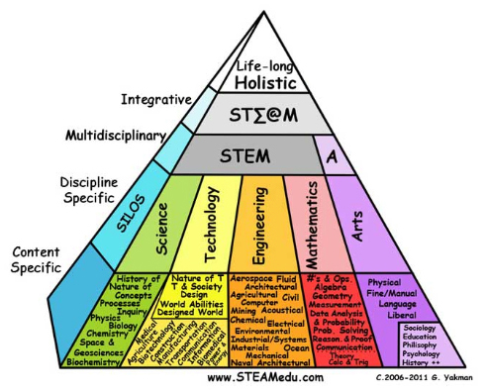
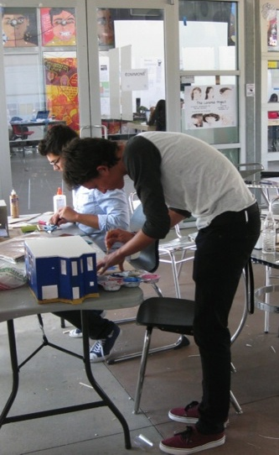
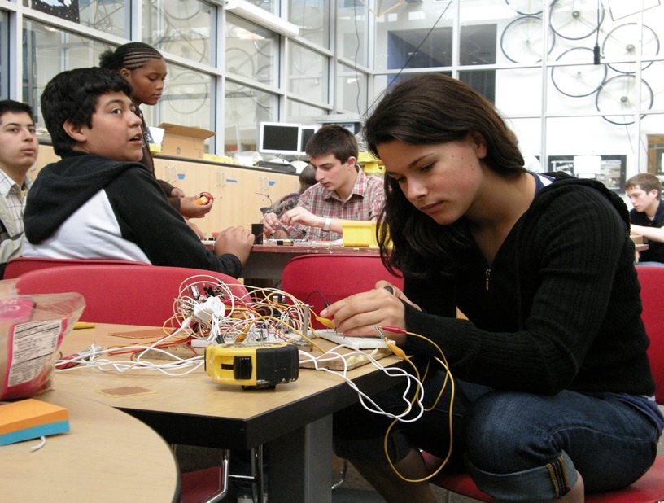
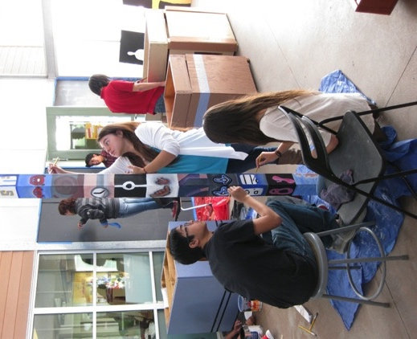
STEM and STEAM
STEM as meta-discipline
Art and Humanities as Glue
Design Thinking Process
newvistadesign

Slide 36
Design
Patterns

Slide 37
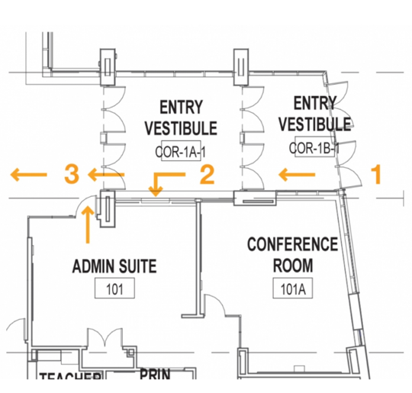

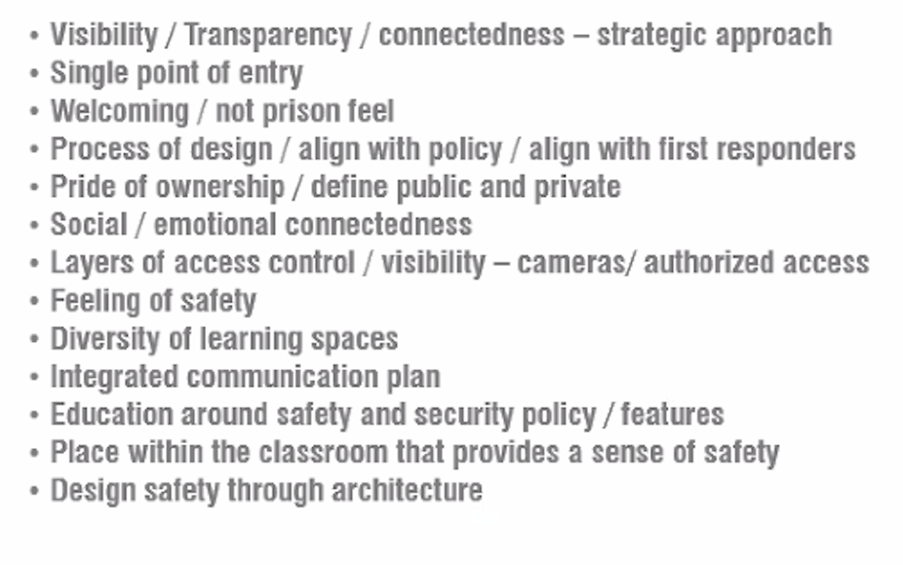
New School
Design Patterns
Safety and
Security
Sanford Regional Technical Center – Lavelle Brensinger with New Vista
SMMA
Notes:
Sustainability, ADA, Repurposing of Existing Structures, Modifications of Existing Structures, 21st Century Learning Environments

Slide 38


New School
Design Patterns
Welcoming Arrival
Safe Drop-off/Pick-up
Stow Center School - SMMA
Bancroft Elementary - SMMA
Winchester High School - SMMA
Sacred Heart - Sasaki
Wellington Elementary - JLA
Notes:
Sustainability, ADA, Repurposing of Existing Structures, Modifications of Existing Structures, 21st Century Learning Environments

Slide 39


New School
Design Patterns
Wayfinding and Streetscapes
High Tech Middle - Carrier Johnson with New Vista
Lunenburg Middle High School – Tappé Architects
Notes:
Sustainability, ADA, Repurposing of Existing Structures, Modifications of Existing Structures, 21st Century Learning Environments

Slide 40


New School
Design Patterns
Natural
Light
Field School - JLA
HTHCV K-8 – Studio E
The Field School - Perkins Eastman
MLK Lower School Perkins Eastman
Oracle d.Tech High School – DES with New Vista
Notes:
Sustainability, ADA, Repurposing of Existing Structures, Modifications of Existing Structures, 21st Century Learning Environments

Slide 41






New School
Design Patterns
Sustainability/
Building as Teacher
HTHCV – Studio E
Ayer - SMMA
MLK Upper – Perkins Eastman
High Tech High – NTD and New Vista
High Tech Elementary North County C – Studio E
Notes:
Sustainability, ADA, Repurposing of Existing Structures, Modifications of Existing Structures, 21st Century Learning Environments

Slide 42

New School
Design Patterns
Agile
Classrooms
SMMA
QKA
MLK Lower School - Perkins Eastman
Notes:
Sustainability, ADA, Repurposing of Existing Structures, Modifications of Existing Structures, 21st Century Learning Environments

Slide 43


New School
Design Patterns
Classroom Neighborhoods
New School
Design Patterns
West Bridgewater MHS – Flansburgh / New Vista
Notes:
Sustainability, ADA, Repurposing of Existing Structures, Modifications of Existing Structures, 21st Century Learning Environments

Slide 44


Extended
Learning Spaces
New School
Design Patterns
HTHCV K-8 – Studio E
Sanford HS– Lavallee with New Vista
Ivan Smith Elementary - Tappé Architects
Da Vinci Schools – Gensler with New Vista
Da Vinci Wiseburn HS – Gensler with New Vista
Birralee Primary / School Thompson Architects
Notes:
Sustainability, ADA, Repurposing of Existing Structures, Modifications of Existing Structures, 21st Century Learning Environments

Slide 45



New School
Design Patterns
Outdoor Play
and Learning
Penn Brook Elementary - DRA
Bancroft Elementary – SMMA
Minuteman Tech – KBA with Locker Planning and New Vista
Notes:
Differentiated learning means tailoring instruction to meet individual needs and we achieve this in our designs by providing a diversity in our environments that affords the individual student a space to thrive. Improves learning outcomes, increases engagement, inspires a love of learning, helps students learn more efficiently w/ deeper understanding

Slide 46

New School
Design Patterns
Safe Community Use
and Access
New School
Design Patterns
West Bridgewater MHS2 - Flansburgh with New Vista
Notes:
Sustainability, ADA, Repurposing of Existing Structures, Modifications of Existing Structures, 21st Century Learning Environments

Slide 47


New School
Design Patterns
Heart of the School
Need Attribution
West Bridgewater MHS – Flansburgh with New Vista
Somerville High School - SMMA
Notes:
Sustainability, ADA, Repurposing of Existing Structures, Modifications of Existing Structures, 21st Century Learning Environments

Slide 48




Maker Classrooms and Maker Spaces
New School
Design Patterns
NUVU Studios – Cambridge, MA
NUVU Studios – Cambridge, MA
NUVU Studios – Cambridge, MA
Abington High School – Ai3 with New Vista
Beverly Middle School – Ai3
Plymouth South High School – Ai3
Notes:
Sustainability, ADA, Repurposing of Existing Structures, Modifications of Existing Structures, 21st Century Learning Environments

Slide 49


New School
Design Patterns
Media Center
Learning Commons
Gibbs Middle School - Finegold Alexander with New Vista
Gibbs Middle School – Finegold Alexander
Somerville High School - SMMA
Need Attribution
Notes:
Sustainability, ADA, Repurposing of Existing Structures, Modifications of Existing Structures, 21st Century Learning Environments

Slide 50




New School
Design Patterns
Enrichment
Spaces
Winthrop MHS - HMFH
Winchester High School - SMMA
High Tech High – NTD and New Vista
SMMA
Ayer Shirley High School - SMMA
Winchester High School - SMMA
Notes:
Sustainability, ADA, Repurposing of Existing Structures, Modifications of Existing Structures, 21st Century Learning Environments

Slide 51


New School
Design Patterns
New School
Design Patterns
Career Tech Spaces
Essex Tech – Perkins Eastman with New Vista
West Bridgewater MHS – Flansburgh with New Vista
Notes:
Sustainability, ADA, Repurposing of Existing Structures, Modifications of Existing Structures, 21st Century Learning Environments

Slide 52



New School
Design Patterns
Professional
Work Areas
New School
Design Patterns
West Bridgewater MHS – Flansburgh with New Vista
Beverly Middle School – Ai3 with New Vista
Notes:
Sustainability, ADA, Repurposing of Existing Structures, Modifications of Existing Structures, 21st Century Learning Environments

Slide 53
Blue Sky Aspirational
Ideas for MSD Facilities

Slide 54



c Kunskapskkolan

Slide 55
Next Steps
Series of three Educational Visioning Group Workshops
Workshops with MSD Elementary, Middle, and High School Faculty
Additional Community Workshops

Slide 56
Q & A

